Slide 1

NAME OF PROJECT
DATE
Customers and Sales Insights
09/09/2025
ROCKBUSTER
STEALTH
DATA INSIGHTS FOR STRATEGIC DECISION-MAKING
NAME OF COMPANY
PRESENTED BY
RockBuster Stealth
Elia Lanzuise

Slide 2
PROJECT QUESTIONS AND OBJECTIVES
ROCKBUSTER IS FACING INCREASED COMPETITION FROM
ONLINE MOVIE RENTAL COMPETITORS, WE REQUIRE NEW
STRETEGIES AND PLANNING IN ORDER TO PERFORM
BETTER AND STAY IN THE MARKET COMPETITEVELY.
WHICH COUNTRIES BRING THE HIGHEST REVENUE?
WHERE CUSTOMERS SPEND HIGHEST ON AVERAGE?
WHAT GENRES AND RATING PERFORMS BETTER IN SALES?
IDENTIFY TOP REVENUE-GENERATING COUNTRIES
IDENTIFY HIGHEST REVENUE-GENERATING CUSTOMERS
COMPARE PERFORMANCE ACROSS GENRES AND RATINGS

Slide 3
MOVIE RENTALS STATISTICS
RENTAL RATES
The average rental rate is around $2.98, with prices ranging from $0.99 to $4.99. This shows Rockbuster maintains affordable pricing while still allowing for some variation.
The wide range suggests flexibility in tailoring prices for
different types of films or customer segments.
0.99
0.49
2.98
MINIMUM
MAXIMUM
AVERAGE
→
→
→
RENTAL DURATION
MINIMUM
MAXIMUM
AVERAGE
→
→
→
3
7
5
Most movies are rented for an average of 5 days, with durations varying between 3 and 7 days. This indicates a fairly standard rental cycle, giving customers enough time to enjoy their films while keeping inventory turnover steady.
REPLACEMENT COST
9.99
29.99
19.98
MINIMUM
MAXIMUM
AVERAGE
→
→
→
Replacement costs average at $19.98, with a spread from $9.99 to $29.99. These values highlight the importance of managing physical inventory carefully, as damaged or lost items can have a significant cost impact on Rockbuster’s profitability.

Slide 4
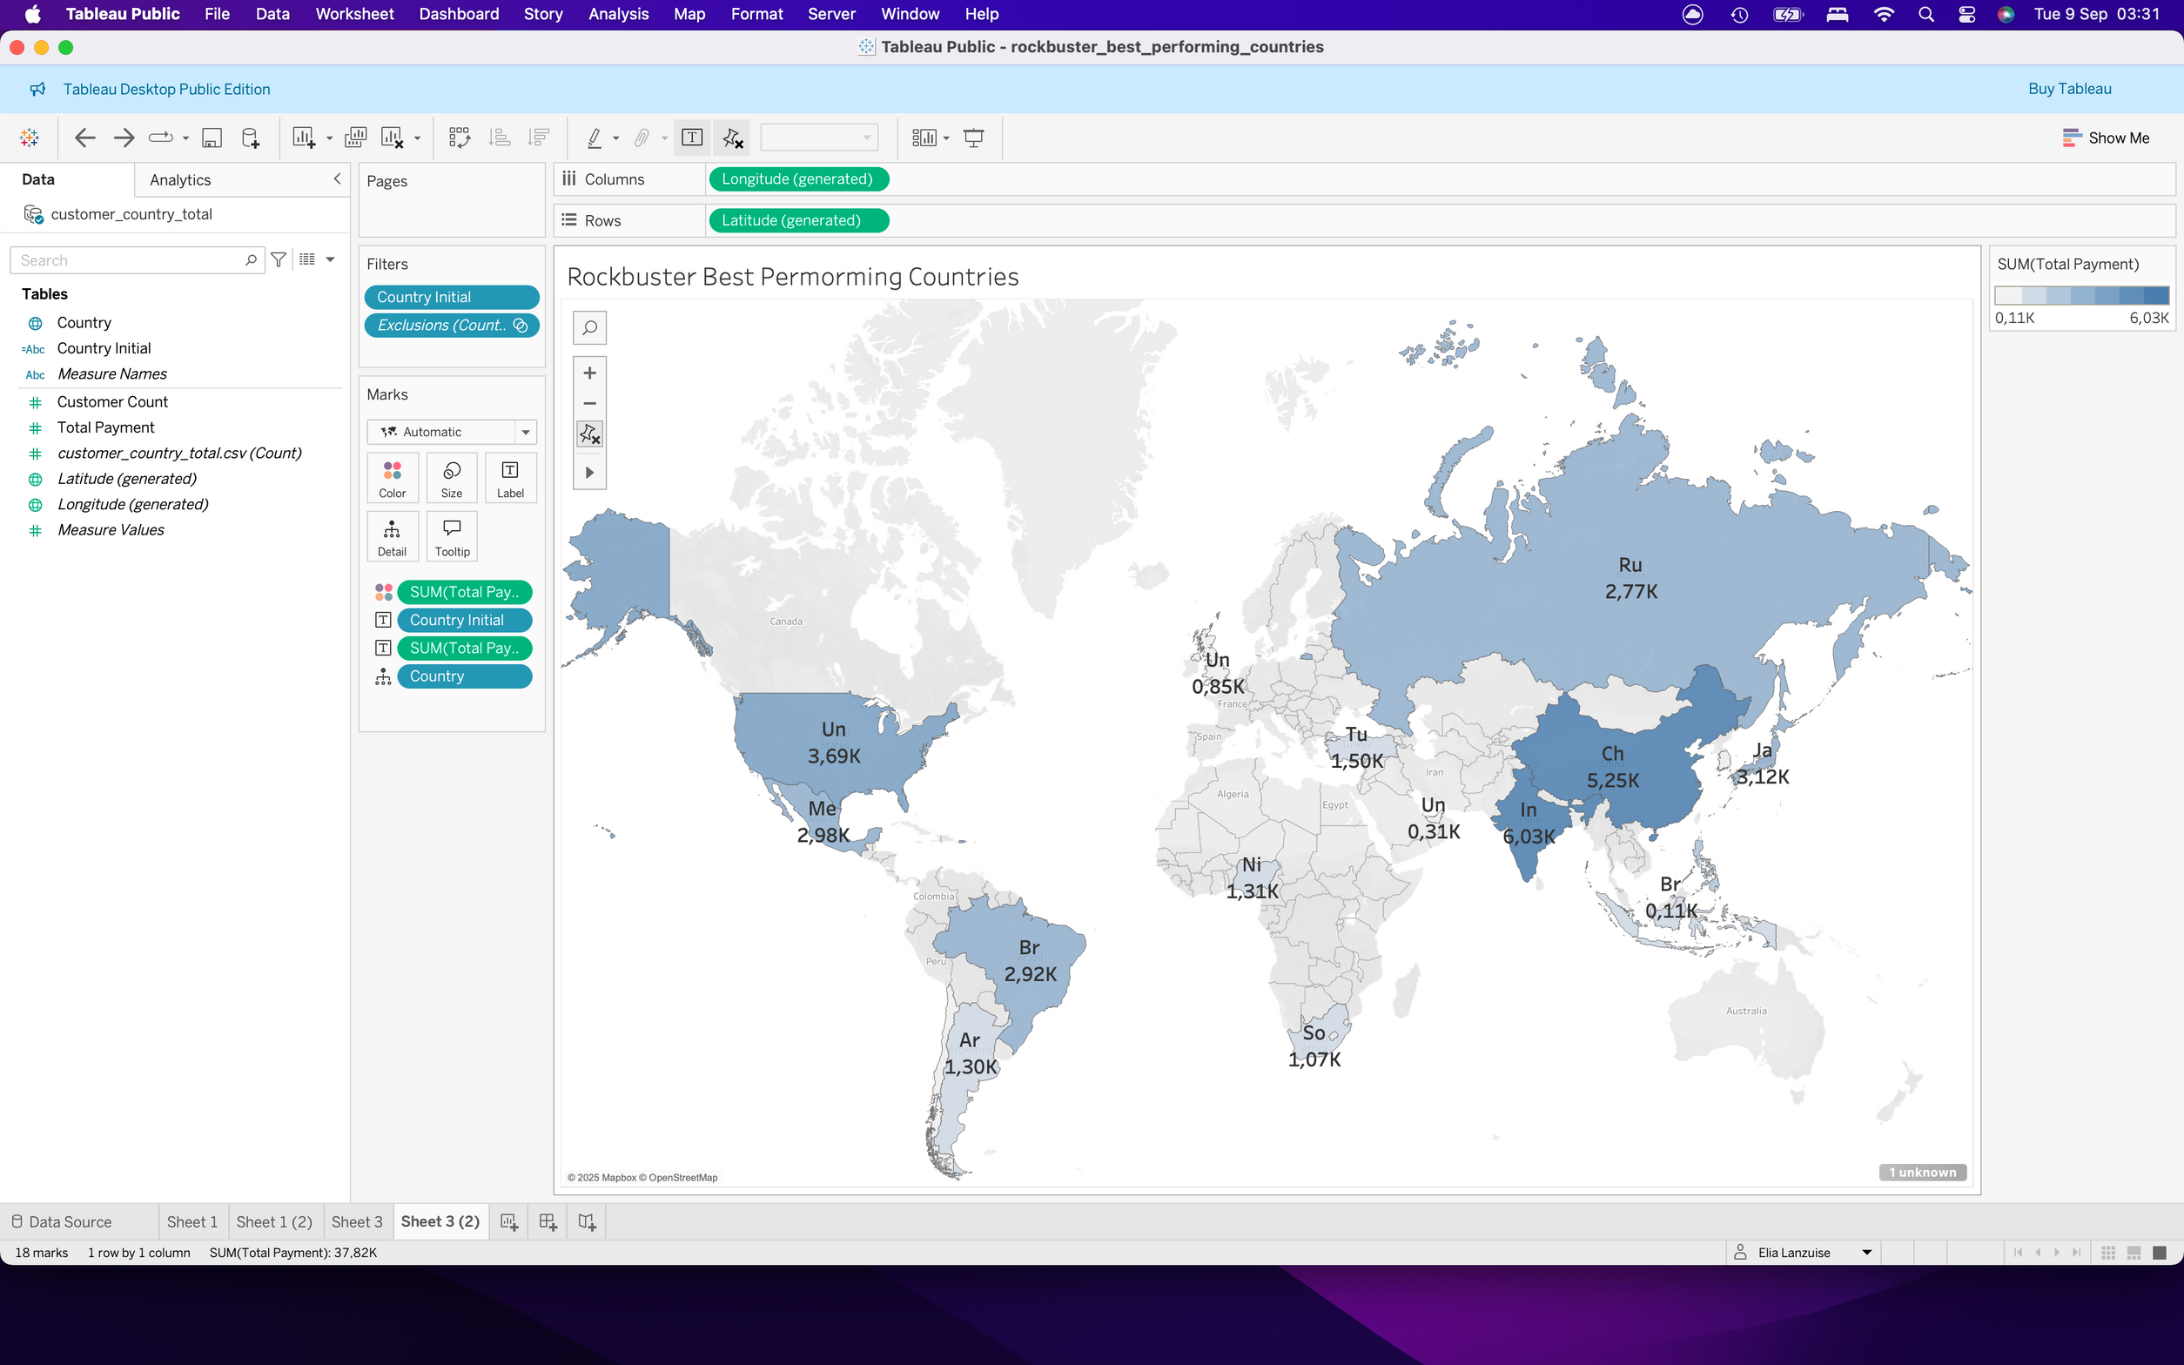
WHICH COUNTRIES BRING THE HIGHEST REVENUE?
Revenue Leaders
India and China stand out as the top revenue-generating countries, followed by the United States and a few strong European markets. These regions represent Rockbuster’s largest customer base and strongest sales potential.
Growth Opportunities
Latin America and parts of Asia show moderate but growing contributions. With targeted marketing or localized strategies, these markets could be expanded to further diversify Rockbuster’s revenue streams.

Slide 5
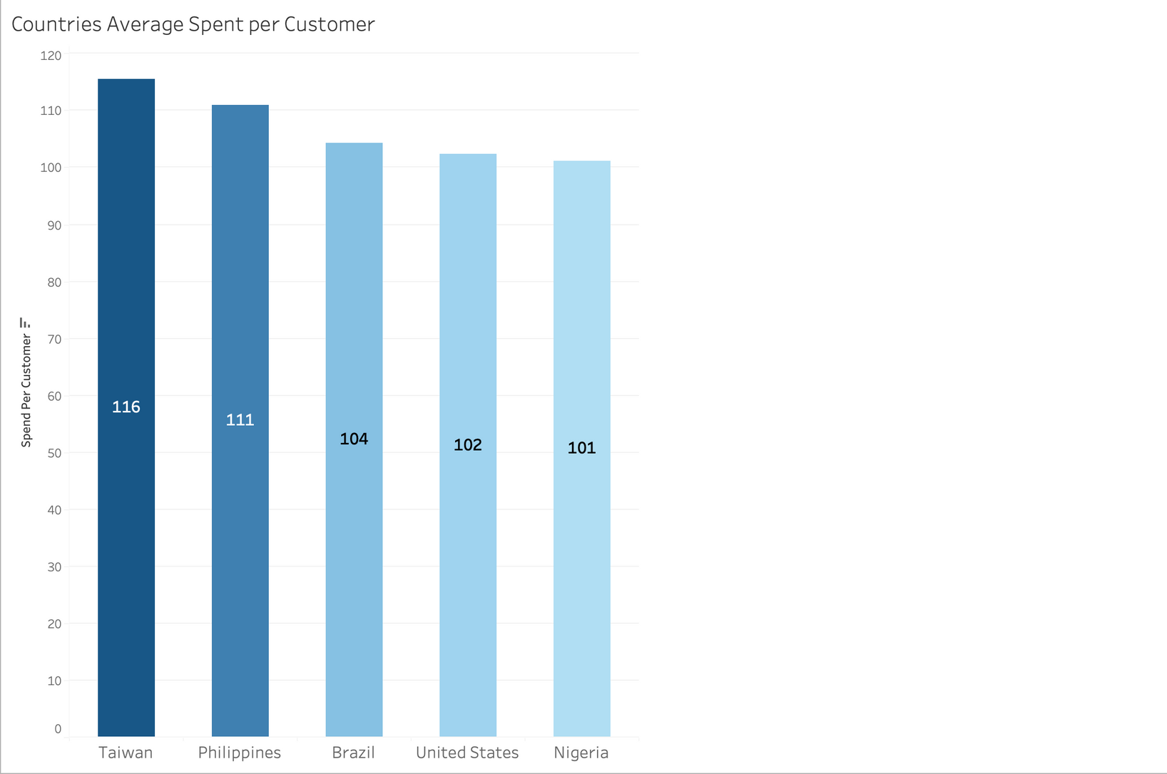
TOP 5 AVERAGE PAYING CUSTOMER COUNTRIES
High-Value Markets
Taiwan and the Philippines lead in customer value, with average spending per customer above $110. These results suggest strong purchasing behavior in smaller but highly engaged markets.
Strategic Insight
Brazil, the United States, and Nigeria also show high per-customer spend, indicating opportunities to strengthen loyalty programs and maximize revenue from already valuable customer bases.

Slide 6
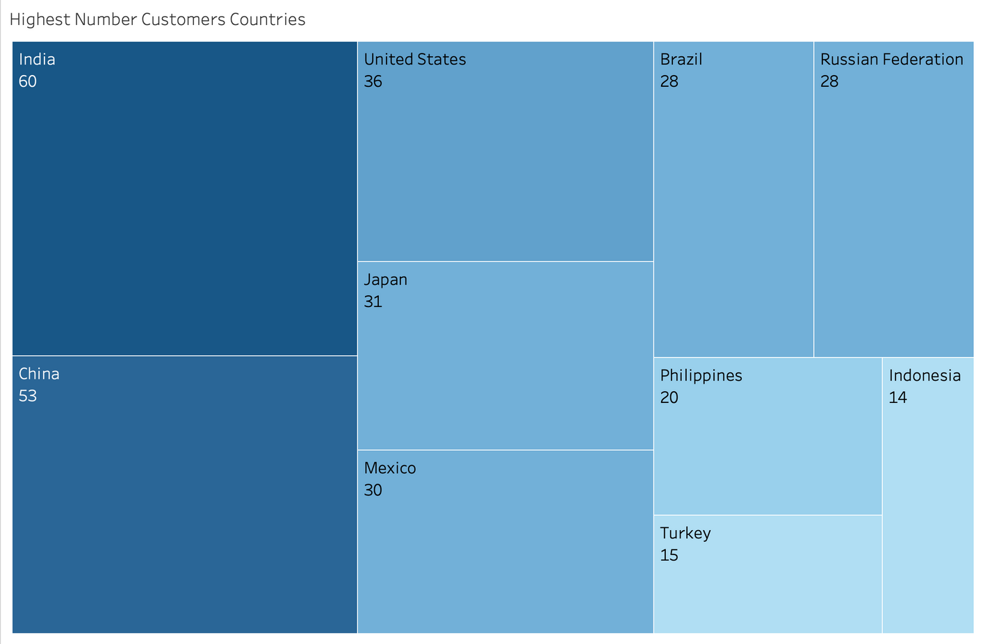
CUSTOMERS HIGHEST NUMBER COUNTRIES
Customer Concentration
Asia dominates Rockbuster’s customer base, with India and China leading in volume, supported by strong numbers in Japan, the Philippines, and Indonesia.
Strategic Opportunity
This spread highlights Asia as Rockbuster’s core growth engine, while the Americas and Europe still provide meaningful scale. Tailored regional strategies could help convert large customer bases into higher revenue per user.

Slide 7
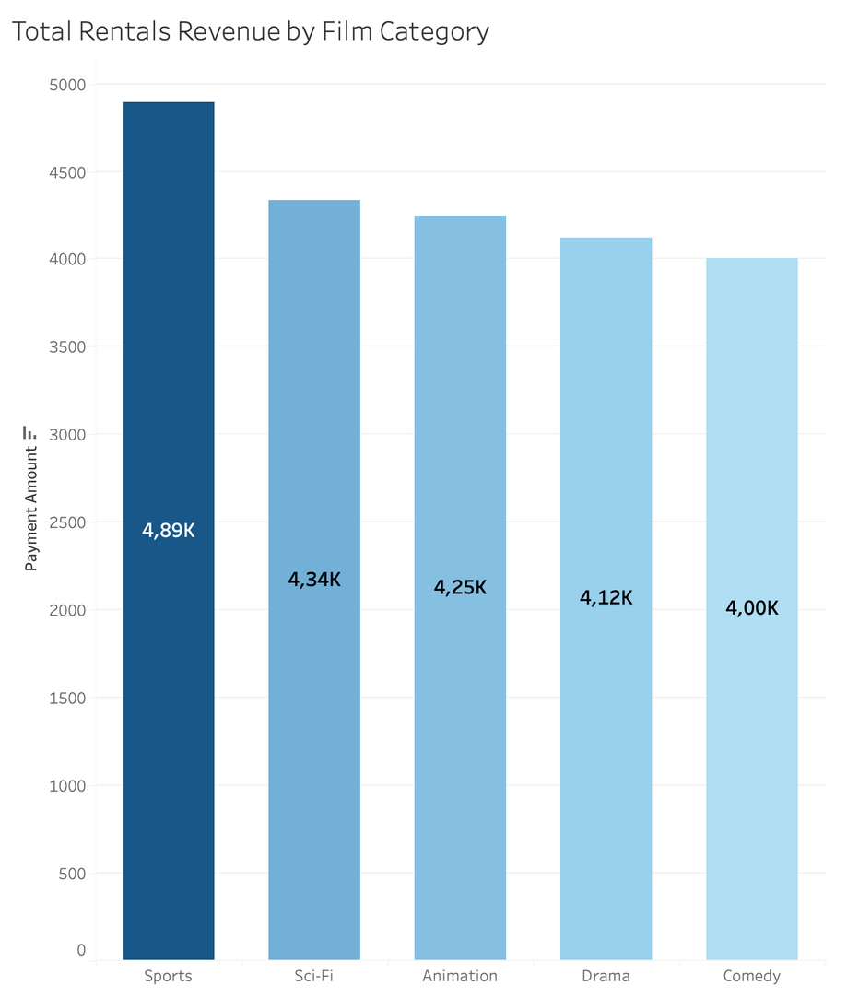
RENTALS REVENUE BY FILM CATEGORY
Revenue Leaders
Sports films generate the highest rental revenue, with nearly 4.9K in payments, ahead of Sci-Fi and Animation. This highlights strong customer demand for entertainment linked to action and competition.
Business Implications
Drama and Comedy, while still significant, trail behind the top categories. Focusing promotions on high-earning genres like Sports and Sci-Fi could maximize returns, while maintaining a balanced portfolio for broader appeal.

Slide 8
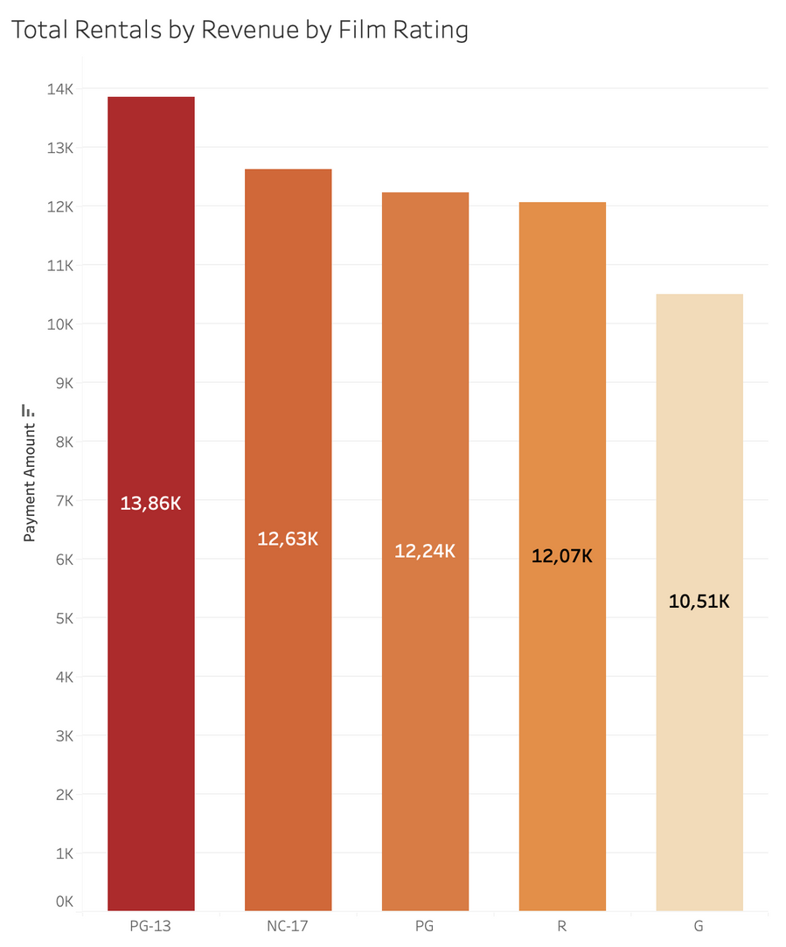
RENTALS REVENUE BY FILM RATING
Revenue Leaders
Movies rated PG-13 bring in the highest rental revenue at nearly 14K, ahead of NC-17 and PG-rated films. This confirms that family-friendly but slightly mature content is Rockbuster’s strongest performer.
Strategic Insight
While other ratings such as R and G also generate solid revenue, the dominance of PG-13 suggests focusing marketing and acquisitions on this rating could yield the highest returns.

Slide 9
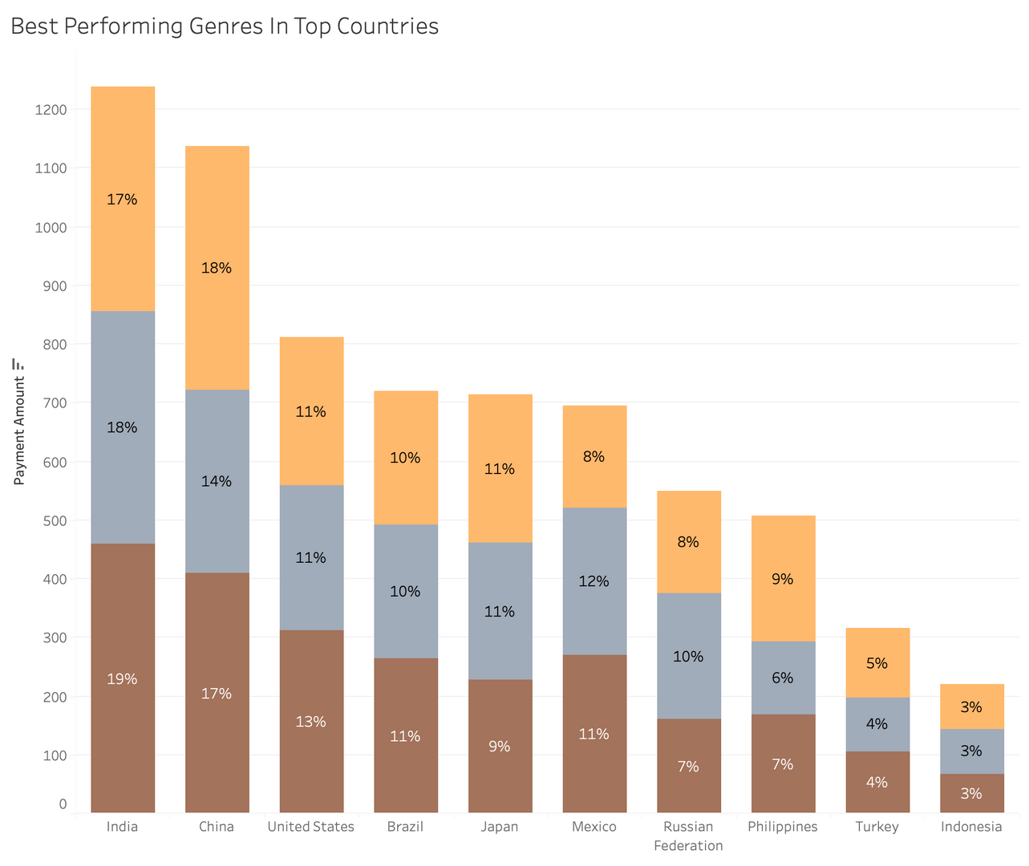
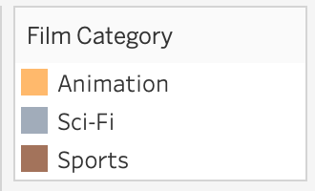
BEST PERFORMING GENRES IN TOP COUNTRIES
Genres Leaders
In top markets, specific genres outperform the rest. For example, Sci-Fi leads in the Russia, while Animation dominates in the Philippines. In China, both Sports and Animation hold a significant edge, and in Mexico, Sports and Sci-Fi show higher traction compared to other categories.
Strategic Insight
Rockbuster can use this knowledge to tailor marketing, doubling down on trending genres in each country, and reassessing investment in weaker categories where customer interest is lower.

Slide 10
KEY TAKEAWAYS
Asia leads Rockbuster’s most profitable customer base, with India, China, Japan and Indonesia driving more revenue, while the U.S. remains the strongest non-Asian market.
Genres show countries differences: Sci-Fi stands out in Russia, Animation in the Philippines, and Sports in the U.S. and India. Could be worth it to improve marketing here to maximise revenue.
Average spend per customer is significantly higher in two countries, with markets like Taiwan and the Philippines that clearly have higher spending customers.
PG-13 films dominate revenue, confirming family-oriented but slightly mature content as Rockbuster’s stronger rating rentals.

